Slide 1
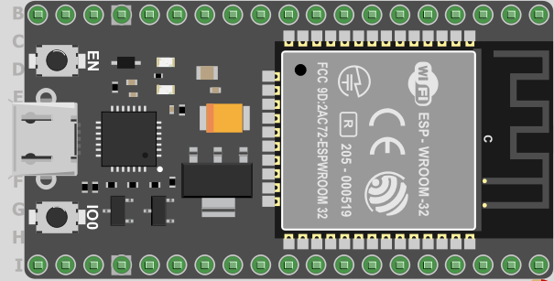
ESP32 board
- MicroPython
Included

Slide 2
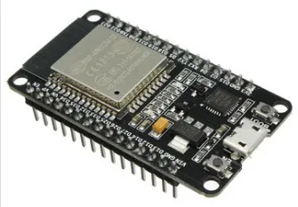
Espressif ESP32 processor
ESP32 — a series of low-cost, low-power, system-on-a-chip microcontrollers https://www.espressif.com/en/products/socs/esp32
240 MHz dual-core chip with similar performance to ARM high-end microcontroller (but higher power budget)
Has built-in industry standard WiFi and Bluetooth capability
Can be programmed in MicroPython once firmware has been downloaded

Slide 3
Micropython http://micropython.org/
MicroPython is a lean and efficient implementation of the Python 3 programming language that includes a subset of the ‘CPython’ standard library and is optimised to run on microcontrollers and in constrained environments.
MicroPython is a full Python compiler and runtime that runs on the bare-metal (no OS). You get an interactive prompt (the REPL) to execute commands immediately, along with the ability to run and import scripts from the built-in filesystem (on-board flash)
The MicroPython compiler/runtime is programmed into the flash memory of the ESP32 (and can be modified/updated)
http://docs.micropython.org/en/latest/esp32/quickref.html for details of ESP32 MicroPython programming functions
Notes:
Follow link at bottom to get code for logging ESP32 onto network
Do demo, but mention membership of ‘dialout’

Slide 4
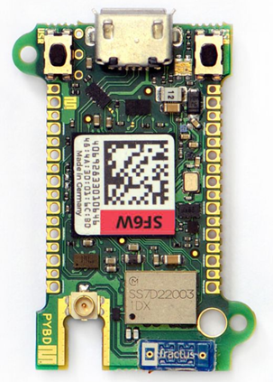
Programming the ESP32
Micropython is based on Python 3; most commands work OK – consulting references is important
Python ‘package’ system works similarly but not the same (called ‘upip’ rather than ‘pip)
Micropython is focussed on low-level hardware interfacing to sensors, etc., as well as communications via WiFi or Bluetooth
Thonny has a ‘MicroPython’ mode, and can use the ESP32 flash file system
[Pyboard D is more expensive alternative processor/board, and runs MicroPython also]

Slide 5
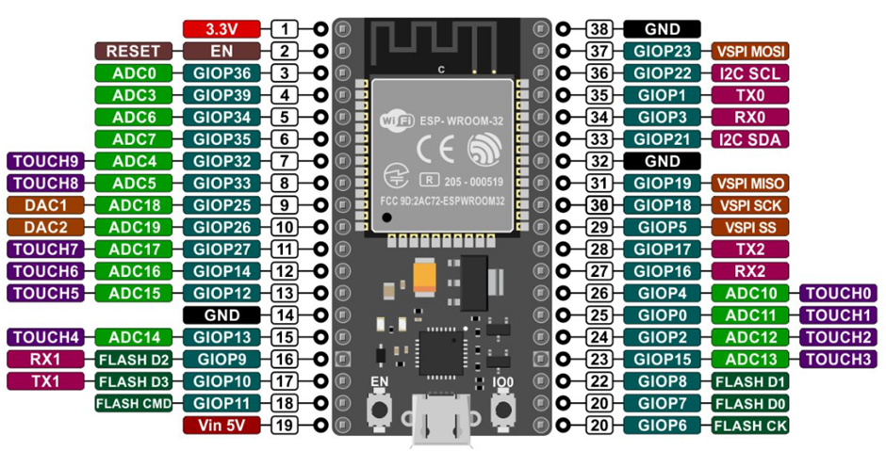
21
ESP32 board pin spacing is 0.1”, making connections easy
Default I/O pin names are GIOPx, where x is 1-39 (not all available). Note: ‘GIOP’ should be GPIO
Pins marked ‘ ’ can not be used for I/O (they connect to flash memory), most of the others can

Slide 6
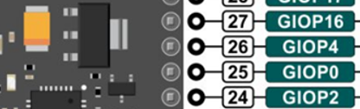
Configuring GPIO pins
Diagram on slide 5 shows physical pin numbers (anticlockwise from top left) 1-38
The internal pin numbering system uses ‘GPIOx’ where x lies between 0 and 39 (not all values available)
When programming, you use the GPIO number to refer to a pin, e.g. LED = Pin(4, Pin.OUT) #GPIO4 is an output called ‘LED’
When wiring, you use the physical pin numbers, GPIO4 is connected to physical pin 26:

Slide 7
Python packages
Many are installed into system flash, and are available using ‘import’
import network makes the wifi networking commands available
import machine and import esp32 make the hardware interfacing commands available, e.g. pin, i²c, spi
Other packages, like drivers for DS18x20 temperature sensors and OLED displays are available for download
The umqtt.simple library provides Paho-like mqtt client functionality, but also needs to be downloaded

Slide 8
Micropython documentation
Best source is the http://docs.micropython.org/en/latest/esp32/quickref.html# web site, which hosts:
Library and Language Reference
MicroPython differences (to Python 3)
Module index
MicroPython Forum – very good, not ‘hobbyist’. You will often get a reply within 24 hours if you are stuck (but don’t ask silly questions)
Well worth reading before posting a query, because many issues have already been answered.
Bluetooth functionality is still in testing stages (June 2020: . . . is now functional)

Slide 9
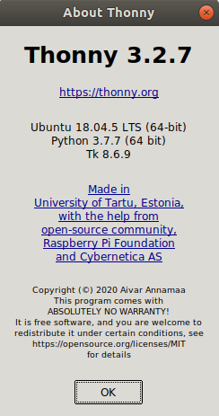
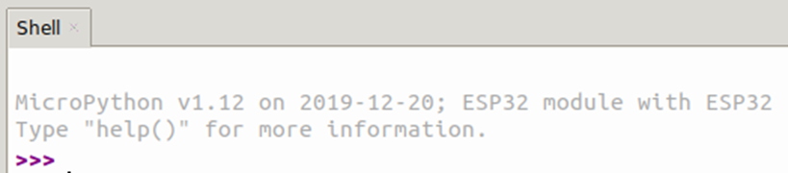
Configuring Thonny 3.2.7
Thonny was chosen because it runs both Python and MicroPython – you choose the ‘interpreter’
Run Thonny, select Tools>Options… and then the ‘Interpreter’ tab. Choose between:
‘The same interpreter which runs Thonny’ currently (Python 3.7) – this is the default we have been using
‘MicroPython (ESP32)’
Thonny then requires a serial port through which to communicate with your ESP32
Note: now v1.17

Slide 10
Warning(s)
Microcontroller pins are not ‘protected’ against incorrect voltages, and the board may be destroyed by one momentary incorrect connection.
NEVER make a connection unless you are sure it is correct
Check, check, and check again
Trying a connection ‘both ways’ will ensure you have it wrong at least once – don’t do it!
Don’t get Python and MicroPython code files mixed up – they are all text files with .py extension, they look similar, and both will run on Thonny
Keep them in separate folders
OR, do something else to stop you getting mixed up

Slide 11
Networking with micropython
The ESP32 has its own WiFi hardware, but no operating system to manage it
We have to write our own networking software, using the ‘network’ module:
The connect() operation will take time, you can check if you are connected using: print(w1.isconnected()) # true or false
>>> import network
>>> w1 = network.WLAN() # my network, called w1
>>> w1.active(1)
>>> w1.connect('SoE-MQTT1', 'robotics129') # use your router info
>>> print(w1.ifconfig()) # once connected, gives you addresses
('192.168.1.212', '255.255.255.0', '192.168.1.254', '192.168.1.254')
>>>

Slide 12
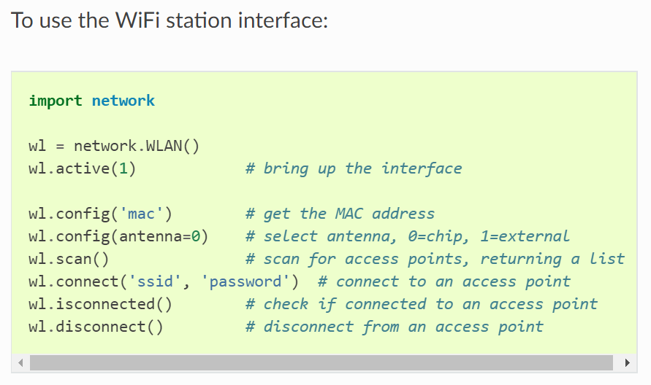
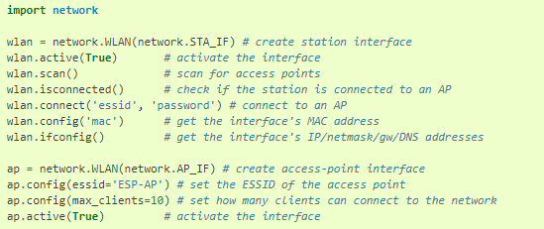
http://docs.micropython.org/en/latest/esp32/quickref.html#networking

Slide 13
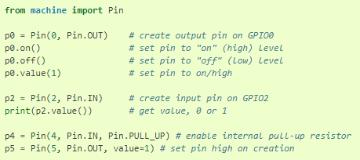
Hardware and Input/output
Available Pins are from the following ranges (inclusive):
0-19, 21-23, 25-27, 32-36, 39 (varies with device version – refer to slide 5).
These correspond to the actual GPIO pin numbers of ESP32 chip.
It should be clear that you will need to use the documentation before using these functions

Slide 14
Connecting external devices
The various pins around the ESP32 provide additional points for us to connect external devices. They are called ‘GPIO’ pins = General Purpose Input/Output pins
The ESP32 makes available two ways of referring to these GPIO pins (see slide 5)
Its own GPIOx system, e.g. GPIO23
Physical pin number, e.g. 37
We will connect an LED and resistor in series with this pin, and then use a logic 1 to switch it ON
GPIO23
220 ohm
Resistor
Red LED
GND

Slide 15
Prototyping Board
0.1”
0.1”
Rapid construction and testing of ideas
Circuits can be built quickly without solder
Connecting wires are minimised by interconnected sockets
Note that some interconnections are vertical, whereas power supply connections are horizontal
Standard 0.1” pitch used throughout
Insulating channel
Positive 3.3 V or 5 V
Ground or negative
Wires, components
Wires, components
Power Supplies

Slide 16
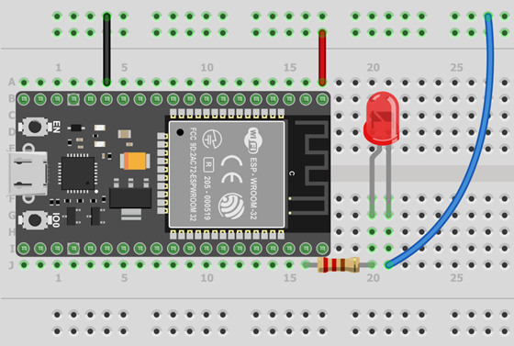
Prototype board layout
LED/resistor shown connected between GPIO23 and GND (check slide 5)
In component/wire area,using a pin on the same row makes a connection, e.g. ESP32 pin GPIO23 to R1, or R1 to LED
Vertical blue wire connects LED to GND wire

Slide 17
I/O devices
The concluding part of this section of the course relates to the use of I/O devices like sensors, switches, actuators, etc.
These will capture/generate the data and control signals for IoT applications
MicroPython (the organisation) have developed drivers for a whole range of devices. Individuals have posted details of others on the Internet
Recent developments are described on the forum at https://forum.micropython.org/

Slide 18
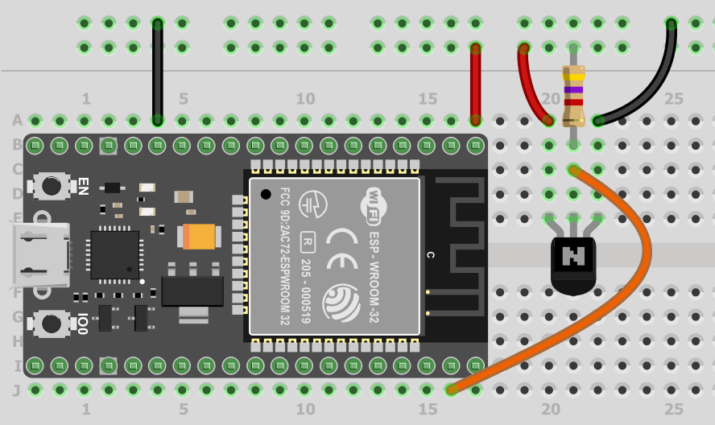
DS18x20 Temperature sensor connections
0V
Flat
Face
+3.3V
4.7k
+3.3V
0V
DS18x20
Pay attention to connections and orientation of flat face of sensor

Slide 19
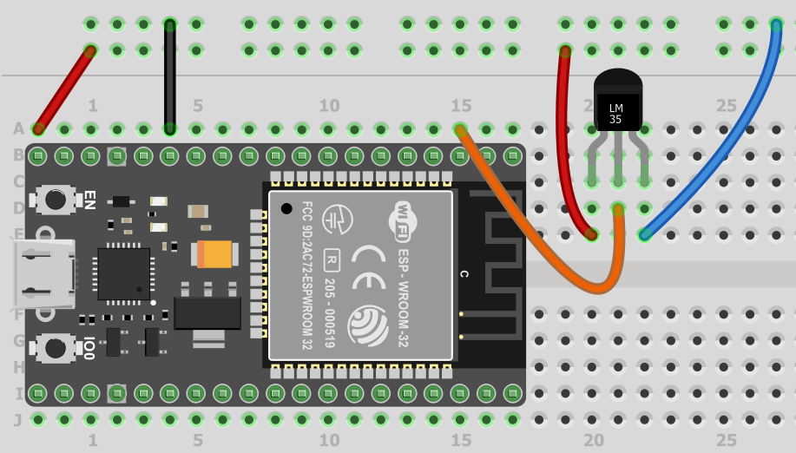
LM35 Temperature sensor
0V
+5V
+5V
0V
sensor
signal
C1
1
3
LM35 temperature sensor is a 3-pin device, requiring +5V supply
Pin1: +5V supply
Pin2: temperature sensor signal, 10mV/degree C
Pin3: 0V Ground
Pin C1 converts analog voltage, V -> number, n
where V = n x 1.0/4096
2
0V

